Slide 1
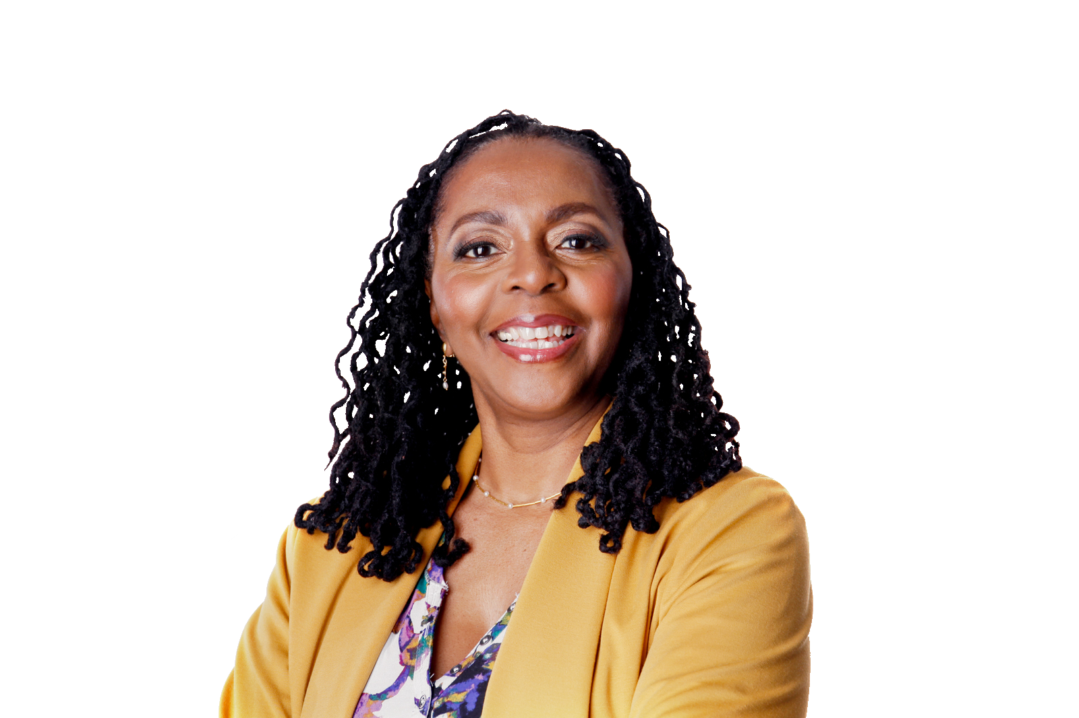
Overview of DEIA and Implementing it into Internal Organizational Systems
with Donna Walker-Kuhne
Today’s webinar will begin at 3:30 p.m. ET

Slide 2
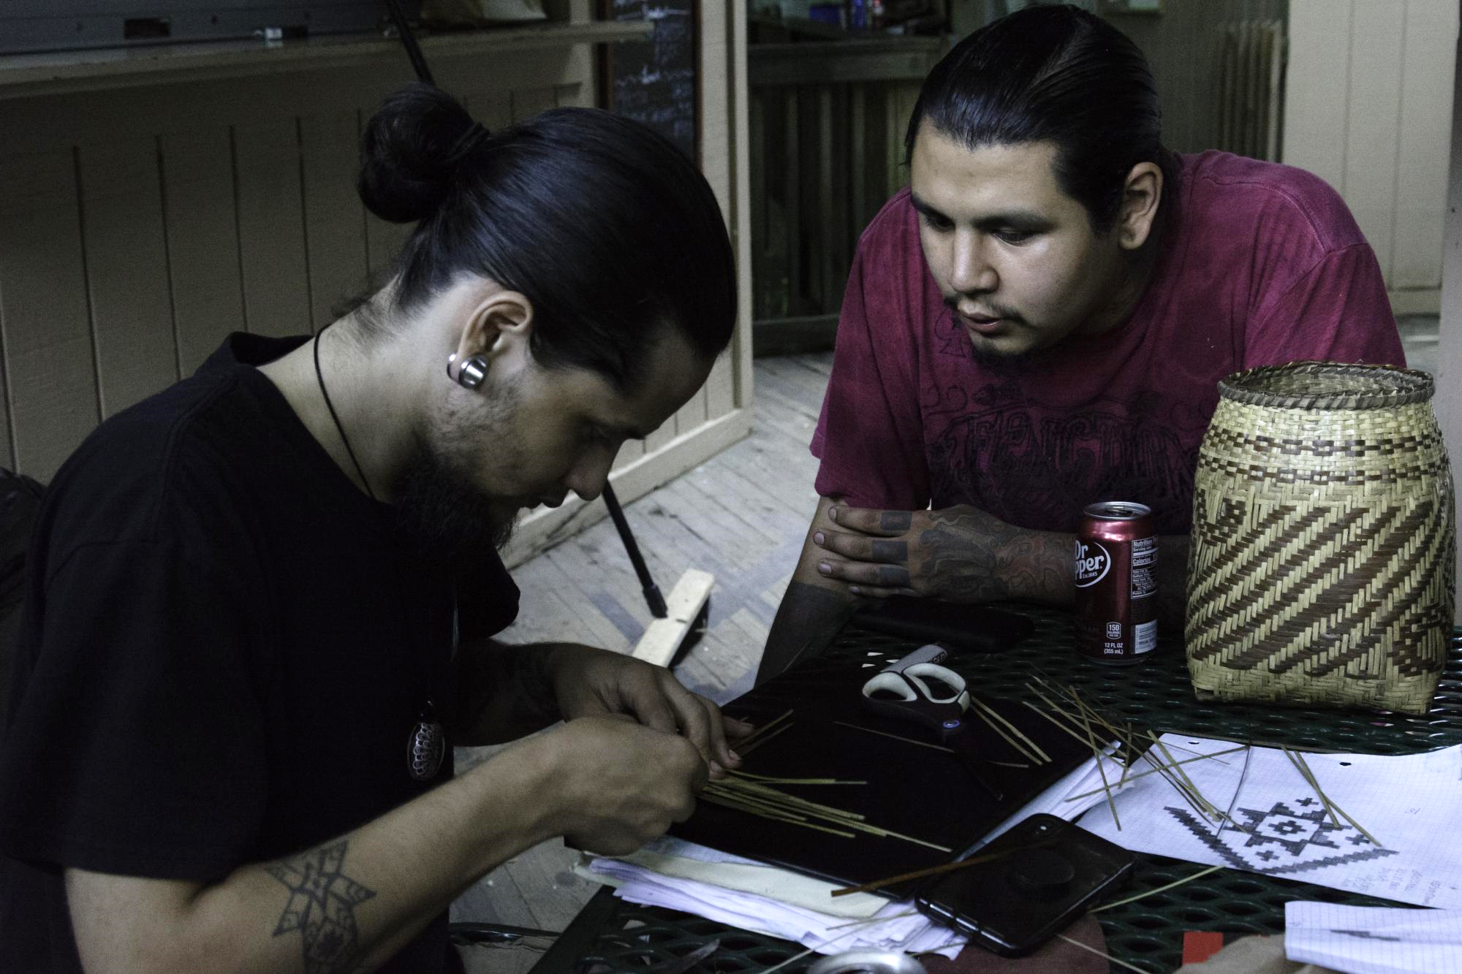
About South Arts
Mission: Advancing Southern Vitality Through the Arts
WE DO THIS THROUGH
Grants & Fellowships
For Artists
For Organizations
For Communities
Programs
Conferences & Convenings

Slide 3
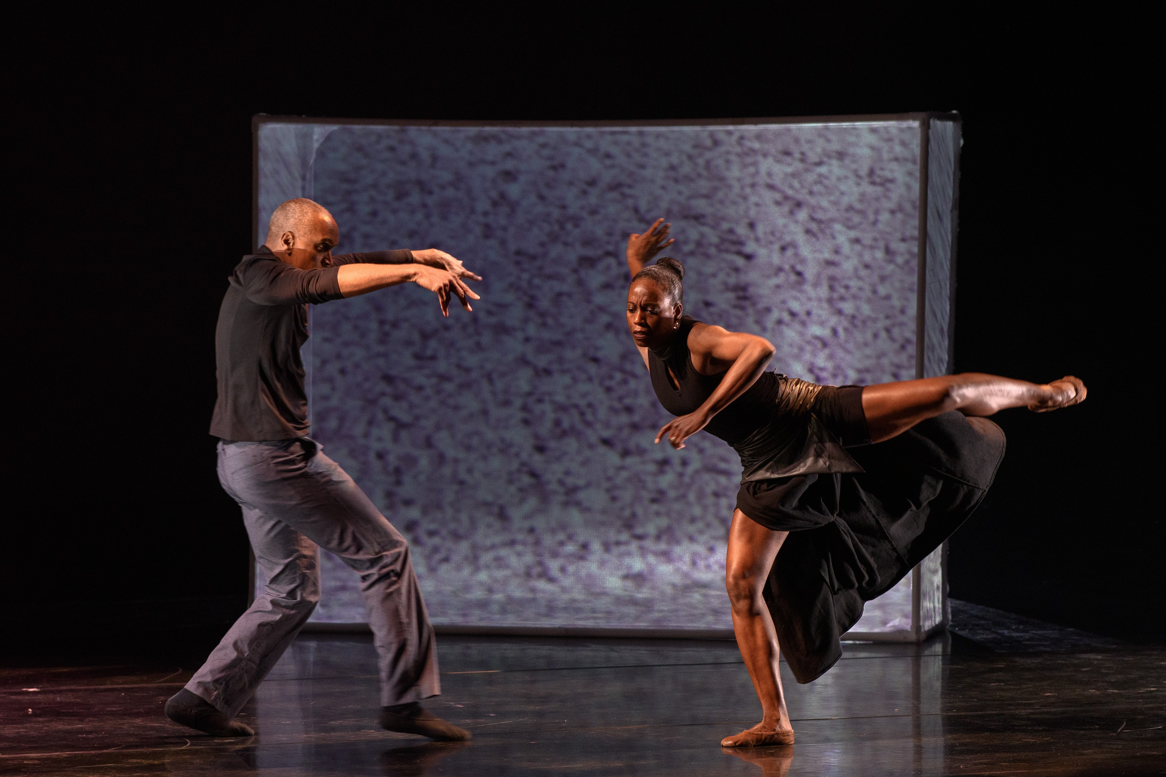
Commitment to Equity

Slide 4
Large Meeting Etiquette
Mute
Chat Box Q&A
Breakout Rooms
Raise Hand

Slide 5
Overview of DEIA and Implementing it into Internal Organizational Systems
Donna Walker-Kuhne
May 20, 2021

Slide 6
AGENDA
OVERVIEW – INTRODUCTION
PARTICIPATION COMMITMENT
SIGNIFICANCE OF SELF WORK – We will discuss the individual preparation and discipline necessary to embrace diverse cultures
VOCABULARY: DEIA, Microaggression, Unconscious Bias, Allyship
ACTION STEPS
ROLE OF THE BOARD
HOW TO START
BREAK OUT
WRAP UP – NEXT STEPS

Slide 7
Where are we now?
We are in process, we have defined the need and it is articulated in a variety of ways within our arts sector. Many arts organizations have issued statements that are on their websites and are board approved. There has been funding allocated specifically for this purpose. We are on the cusp of implementation and sustainability that will allow us assess the long term impact.

Slide 8
BECOME PIONEERS OF A BETTER AGE
“There is no other solution to the problem of racial discrimination than realizing the human revolution in each individual. In other words, an inner reformation in the depths of people’s lives to transform the egoism that justifies the subjugation of others and replace it with a humanism that strives for coexistence among all people”
Daisaku Ikeda

Slide 9
MOVING FORWARD WITH 3 PANDEMICS
“Historically, pandemics have forced humans to break with the past and imagine their world anew. This one is no different. It is a portal, a gateway between one world and the next. We can choose to walk through it, dragging the carcasses of our prejudice and hatred, our avarice, our data banks and dead ideas, our dead rivers and smoky skies behind us. Or we can walk through lightly, with little luggage, ready to imagine another world. And ready to fight for it.”
Arundhati Roy

Slide 10
FROM THE FIELD
Sandra Jackson Dumont, President, The Lucas Museum reminds us that, "There is no end date for diversity, bias-awareness and inclusion work. If an organization is to ensure equitable access and opportunities for everyone, the work should be a part of the DNA of the entire organization.”

Slide 11
FROM THE FIELD
Brave spaces – Dr. Indira Etwaroo, talks about how to contribute to engaging diverse communities dealing with empowering internally staff so that the culture is where one can speak freely without fear of repercussions. Creating brave spaces to create change. Imagining beyond physical and imagined boundaries. Imagining beyond your circumstances. Models like the civil rights movement and global community acts of revolution. Brave space is where people can step out and create change.

Slide 12
Darren Walker, Ford Foundation
“I think diversity, for me, is about excellence. I think regrettably, diversity was framed by some and continues to be framed in a way that suggests that diversity correlates with a loss of quality. And actually, what the research shows, the empirical evidence is that diversity makes organizations better. The more diverse organizations by empirical indicators are, the more excellent they are at whatever their mission—whether it is IBM, the Ford Foundation, or a ballet company. I actually don’t talk about diversity without talking about excellence. Diversity is a contributor to excellence.”

Slide 13
It’s The Heart That Matters
When you transform your heart, your everyday actions will undergo a change and you can even transform your environment. The creation of an ideal world begins with the metamorphosis of a single individual.
Daisaku Ikeda, WT – 8-6-20

Slide 14
Diversity
Diversity - representation of all our varied identities and differences (race, ethnicity, gender, disability, sexual orientation, gender identity, national origin, tribe, caste, socio-economic status, thinking and communication styles, etc

Slide 15
EQUITY
Equity seeks to ensure fair treatment, equality of opportunity, and fairness in access to information and resources for all. We believe this is only possible in an environment built on respect and dignity. Inclusion builds a culture of belonging by actively inviting the contribution and participation of all people.
Source: The Ford Foundation

Slide 16
Inclusion
Inclusion builds a culture of belonging by actively inviting the contribution and participation of all people. We believe every person’s voice adds value, and we strive to create balance in the face of power differences. We believe that no one person can or should be called upon to represent an entire community.

Slide 17
Accessibility
Accessibility supports an environment that provides individuals with disabilities an opportunity to participate in our events, programs, benefits, and services that is equal to that of their peers without disabilities.

Slide 18
Microagressions
Small daily insults and indignities perpetrated against marginalized or oppressed people because of their affiliation with that marginalized or oppressed group, and racial microaggressions are insults and indignities perpetrated against people of color. They are hostile, derogatory or negative messages to targeted individuals based on categories like race, gender, sexual orientation.

Slide 19
Impact of microagressions
The cumulative effect of these constant reminders that you are less than does real psychological damage. Regular exposure to microaggressions causes a person of color to feel isolated and invalidated. The inability to predict where and when a microaggression may occur leads to hypervigilance, which can then lead to anxiety disorders and depression.

Slide 20
Unconscious Bias
Is the underlying attitudes and stereotypes that people unconsciously attribute to another person or group of people that affect how they understand and engage with a person or group.
They are automatic, unintentional and often have an effect on our decision making and behavior.
Common biases include:
Physically-based biases, Gender based biases, Age-based biases.

Slide 21
Unconscious Bias Poll
Which one of these is not an example of unconscious bias?
A. Have a different accent
B. Is a single mom
C. Older person may have limitations
D. Have lighter or darker skin
E. He is very attractive
F. Visually impaired
G. Has a degree from an Ivy League College
H. All are unconscious bias

Slide 22
Allyship
As a Manager, how your colleagues navigates this incredibly challenging time. It is equally critical that they feel directly supported by you as their manager. If you proceed with “business as usual,” it sends a message to people that you don’t believe this is an important topic worthy of time and conversation. For staff of color in particular, it can send a message that you don’t value them.

Slide 23
Allyship – Speak to your team
1) Speak to your colleagues. Not just once. Make sure that when you meet as a group, your team understands that this is on your mind and it is important to you.
2.) Talk to your team one-on-one.
3.) Continue your learning and build ally skills.
4.) To be an ally is an active participation where you take risks to be different
5.) Be an upstander – speak out, take action

Slide 24
ACTION STEPS TOWARDS DEIA
How to be as inclusive as possible in working with vendors, artists, production, media and marketing
Everything is a teachable moment – how to advance this concept
Personal and institutional preparation

Slide 25
ACTION STEPS
Do not depend on people of color for your racial education. You can get it in several interconnected ways: Books, websites, films.
Accountability – to whom and when
Human Revolution – this is personal, reflect and do the work consistently
Timeline for implementation and execution – when do you begin?

Slide 26
ROLE OF THE BOARD TOWARDS DEIA
Board members that join any board in this day and age must be willing to jump into a journey to examine how their experiences with race, class, gender, sexual orientation and generation impact how they see the world and operate in it.
The Board should be involved in training, discussions, implementation and fundraising for successful and long term DEIA.

Slide 27
TAKING ACTION FOR CHANGE
Board recruitment should reflect more diversity. Not just for their potential to fundraise but rather to create a balance of people who can bring many types of resources to the organization such as as lived-experience and knowledge of a community.

Slide 28
TAKING ACTION FOR CHANGE
White board members that don’t champion racial equity in a board meeting or fail to interrupt other white members from engaging in paternalizing or direct racist behaviors are seen as supporting racism for failing to act.

Slide 29
JOINT LEARNING
Boards and staff should come together in joint training and learning sessions for the board and staff to explore issues of racial equity. These sessions should include reflection on how issues of racial equity impacts the mission of the organization as well as how it impact the organization’s internal culture and operations.

Slide 30
Break out Question
What are you and or your organization currently doing to activate movement towards Diversity Equity Inclusion and Accessibility?

Slide 31
RECOMMENDATIONS
DEIA Consultant
On-line training
Reading Groups
Employee Resource Groups
Board DEIA Committee
Cultural acknowledgements and statements of solidarity

Slide 32
Long term perspective
We must focus on the fact the EDIA work never stops. It is important that our colleagues and partners that have close relationships with us feel that the EDIA initiative is positively reshaping our internal work culture.

Slide 33
There are no shortcuts
THERE ARE NO SHORTCUTS NOR SILVER BULLETS FOR ENABLING INCLUSIVE WORKPLACES. ..YOU CAN SEND A POWERFUL MESSAGE AS AN ALLY IN A POSITION OF POWER AND INFLUENCE WHEN YOU’RE THE ONE WHO TAKES UP THE WORK.
DAISY AUGER-DOMINGUEZ

Slide 34
The Hill We Climb
“…the New Dawn blooms as we free it, for there is always light if only we’re brave enough to see it, if only we’re brave enough to be it.”
Amanda Gorman

Slide 35
QUESTIONS
THANK YOU!
dmw2184@columbia.edu
Blog: Arts&Culture Connections
Walkercommunicationsgroup.com
Author of:
Invitation to the Party: Building Bridges to Arts, Culture and Community

