Slide 1
Incorporating DEIA Externally through Programs and Community Engagement
Donna Walker-Kuhne
June 24, 2021

Slide 2
Agenda
How programming impacts community building and audience development
Strategies for embedding diversity, equity, inclusion and accessibility as components of audience development and community engagement
10 Tools for Building Audiences

Slide 3
What is Audience Development ?
Put your thoughts in the chat

Slide 4
What is community engagement?
Please put comments in the chat

Slide 5
Audience Development
For many years, the terms Audience Development (AD) and Community Engagement (CE) have been used interchangeably. They are different endeavors and yield different results.
The purpose of AD is to create promotional opportunities to sell tickets to an arts or cultural event. The Purpose of CE is to facilitate partnerships and expand access to the arts; to engage in a collaborative process.

Slide 6
Definition
I define audience development as the cultivation and growth of long-term relationships, firmly rooted in a philosophical foundation that recognizes and embraces the distinctions of race, age, sexual orientation, physical ability, geography and class.
Audience development is also the process of engaging, educating and motivating diverse communities to participate in a creative, entertaining experience as an important partner in the design and execution of the arts.

Slide 7
Audience Development is Transactional
At its core, it is an expansion of marketing that targets a specific audience for specific events in order to sell tickets and fill seats. This transactional relationship also requires that the potential patrons attend an event at a specific venue – whether free or a ticket buyer

Slide 8
Community Engagement
The process of promoting the arts as the center of daily life for everyone, it is a process of creating access to the arts. It is the process of taking the arts to the community. It is not a transactional experience. The measurement of success is participation and engagement.

Slide 9
Collaboration
The most important component of both audience development and community engagement is a spirit of collaboration among every department at your organization- a willingness to invest the time, labor and resources needed to be successful.

Slide 10
Strategies for embedding DEIA with Aud Dev & Comm Engagement
Discussions with programming on goals
Who is the demographic you want to reach
How can programming provide content?
How can you create programming that supports community engagement and audience development?
What are the obstacles?

Slide 11
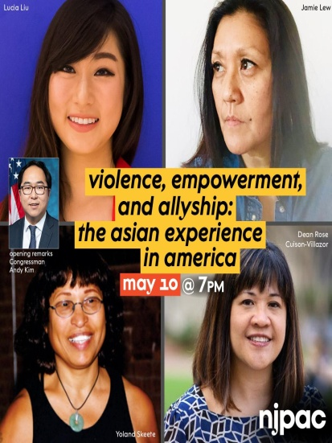
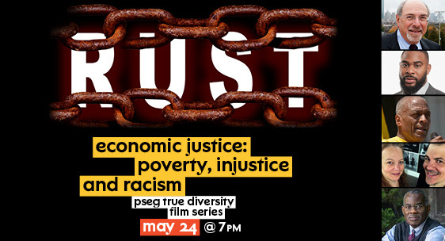
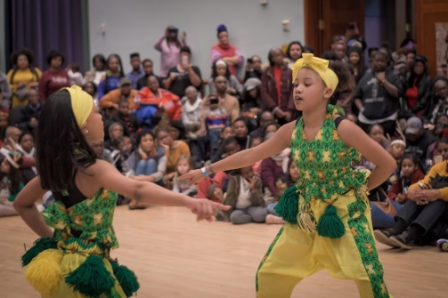
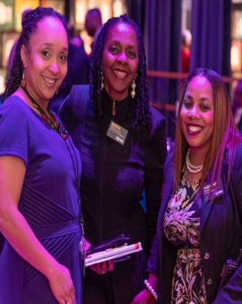
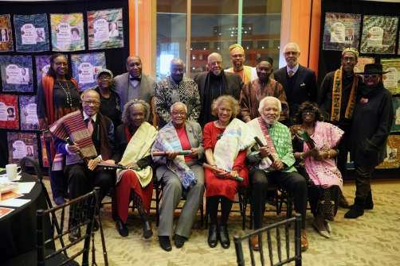
NJPAC COMMUNITY ENGAGEMENT
Created in 2014 to engage new and culturally diverse audiences. Our goal is to develop long-term relationships with multicultural, civic, professional, educational and faith-based organizations that have the potential to create deeper access and a creative use of NJPAC resources and cultural products in the community.
STANDING IN SOLIDARITY SERIES
To bring our community together, and to encourage everyone to take part in the movement to ensure civil rights for all, NJPAC has launched a series of events and initiatives focused on promoting racial equality. On these pages, you can find resources that will help you take action, in the voting booth and elsewhere, and join us for conversations and discussions that can help you understand the issues we’re all grappling with today.
COMMUNITY ENGAGEMENT FACTS
•Produces and/or participates in 200 events with attendance exceeding 19,000 annually.
•Maintains relationship with 120 Engaged Partners that do 3 of the following: Social Media Promotion; Collateral Distribution; Internal Promotion through their organization; Purchase Tickets; Attend a free event.
•Distribute a newsletter e-Blasts to 5,000 recipients annually, celebrating community champions and highlighting events.
•In-person events serve Bergen, Essex, Hudson, Union, Monmouth counties and beyond. Virtually, our events serve nationally.

Slide 12
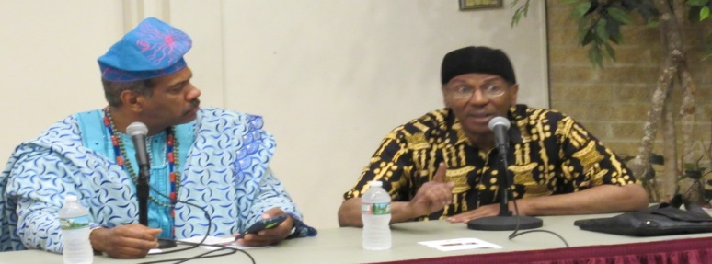
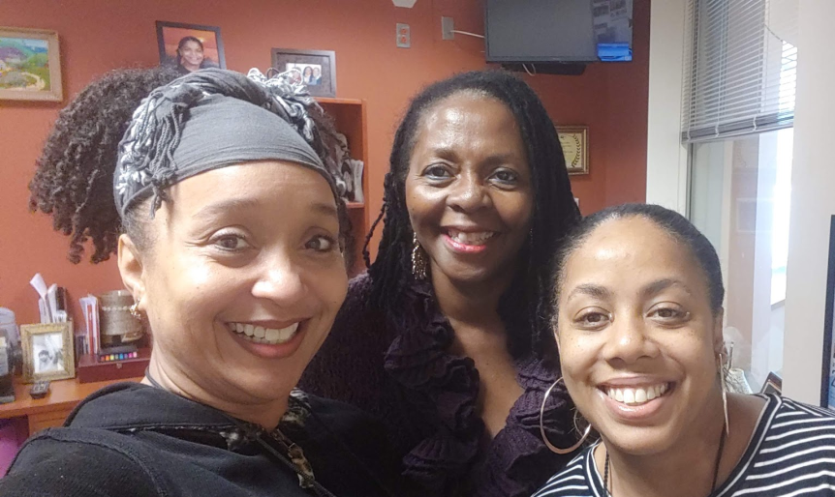
THE ROLE AND HISTORY
The Community Engagement Initiative was created in 2014 as an outgrowth of the Marketing Department and the need to apply targeted strategies and resources to engage new and culturally diverse audiences. The goal of this initiative is to develop long-term relationships with multicultural civic, professional, educational and faith-based organizations that have the potential to create deeper access and a creative use of NJPAC resources and cultural products in the community. Innovative programs such as NJPAC In Your Community have been developed in partnership with community leaders to advance genre related events. These include, jazz, classical music, dance and theater events.
SAMPLE OF ANNUAL INSTITUTIONAL EVENTS
Kwanzaa Celebration
Tribute to the Elders
MLK Awards Reception
PSEG True Diversity Film Series
Author’s Expo
Ailey Dance - Wellness Festival
Community Engagement Facts:
Produces and/or participates in 200 events with attendance exceeding 19,000 annually
Maintains relationship with 120 Engaged Partners that do 3 of the following: Social Media Promotion; Collateral Distribution; Internal Promotion through their organization; Purchase Tickets; Attend a free event
Distribute a newsletter e-Blasts to 5,000 recipients annually, celebrating community champions and highlighting events
In-person events serve Bergen, Essex, Hudson, Union, Monmouth counties and beyond. Virtually, our events serve nationally

Slide 13
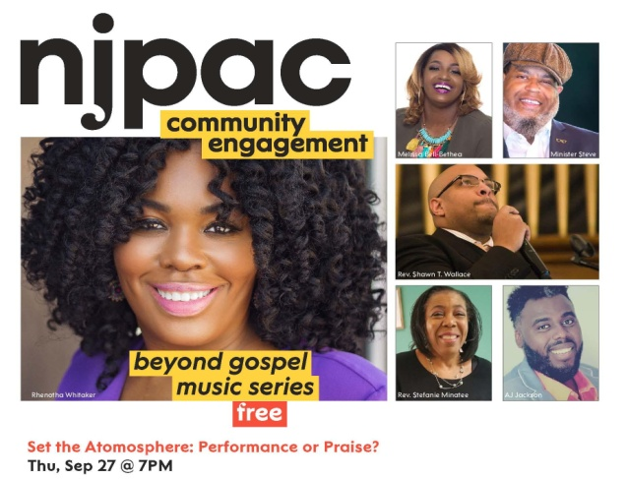
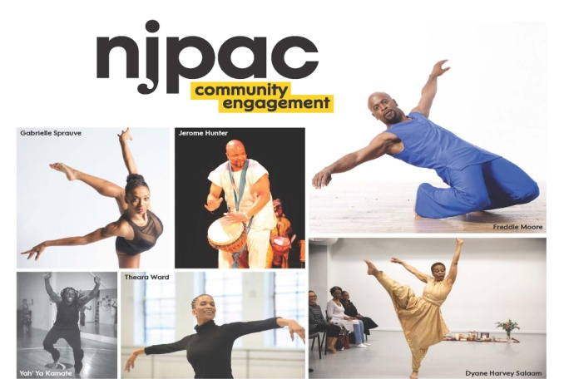
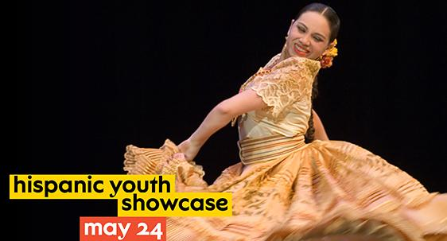
Advisory Council Events
Dance
Dance in Our Community
Elders
Pearls of Wisdom
Elder’s Stories
Tribute to the Elders
Faith Based
Beyond Gospel Music
Jazz
Jazz Jams at Clement’s Place
Latino
Hispanic Youth Showcase, Jazz, Dance & Tabling
LGBTQ
Free Form at Nico

Slide 14
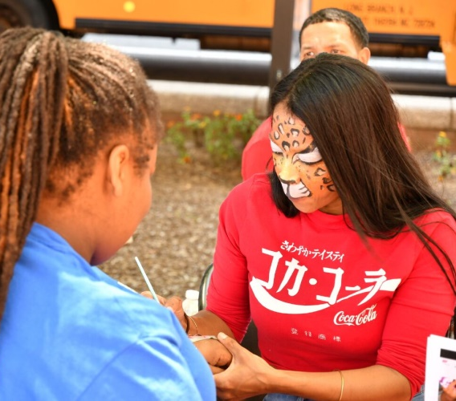
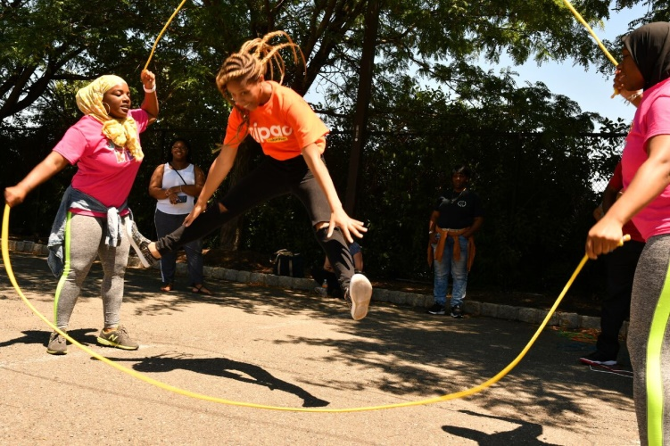
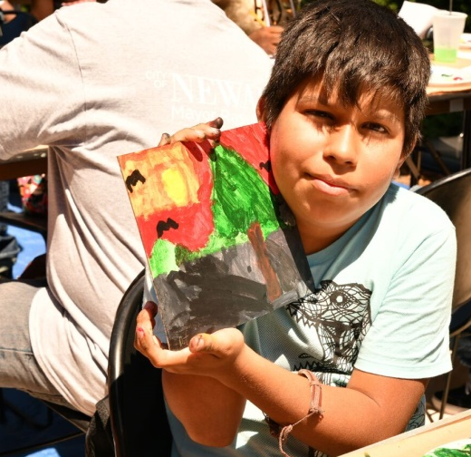
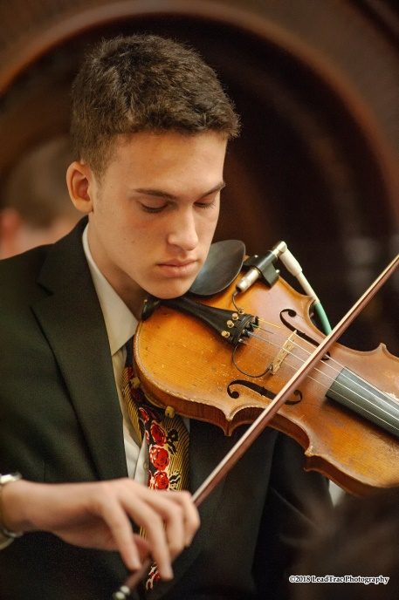
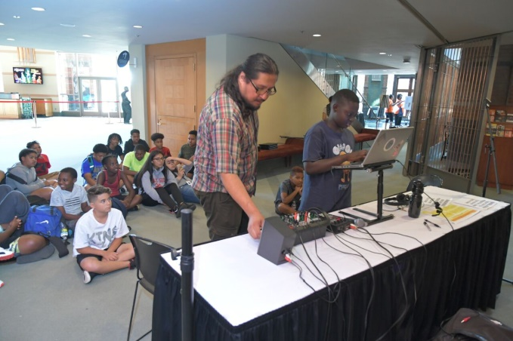
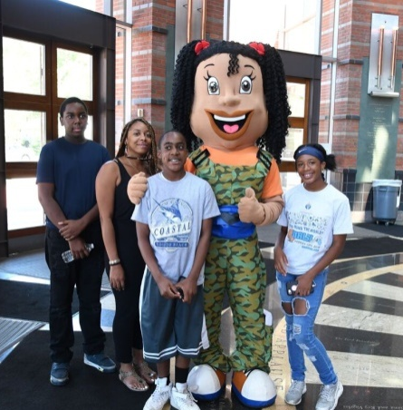
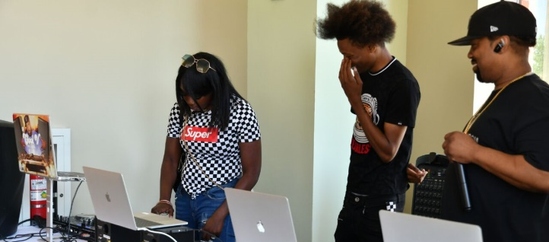
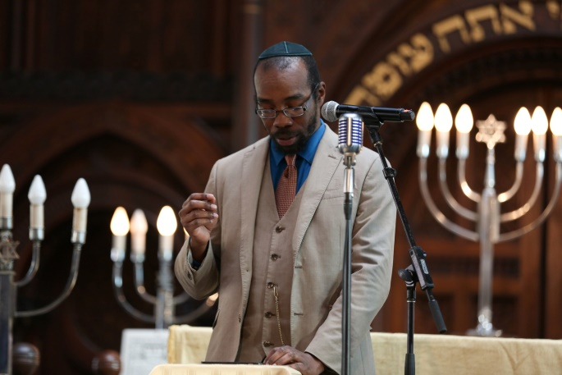
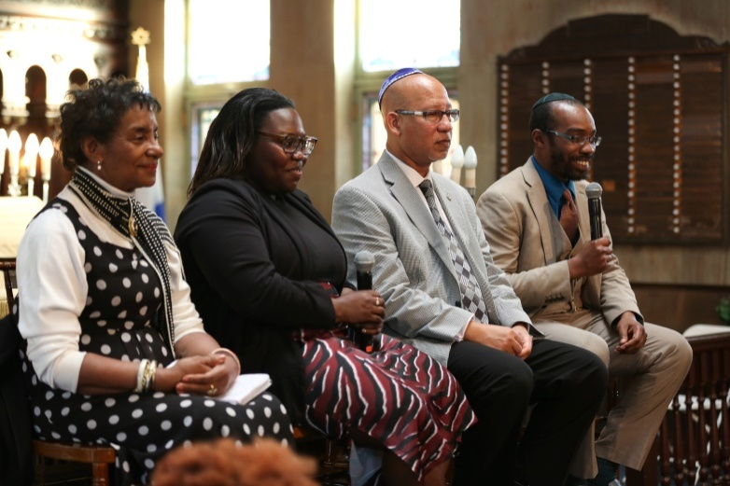
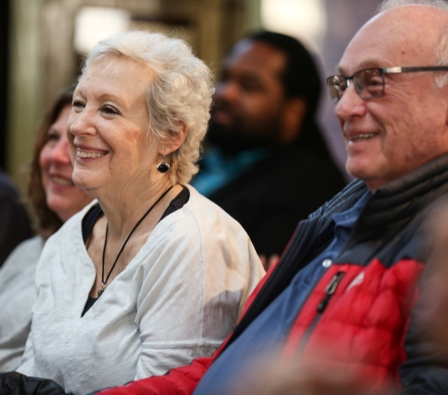
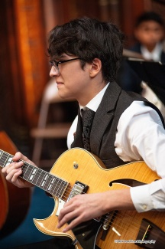
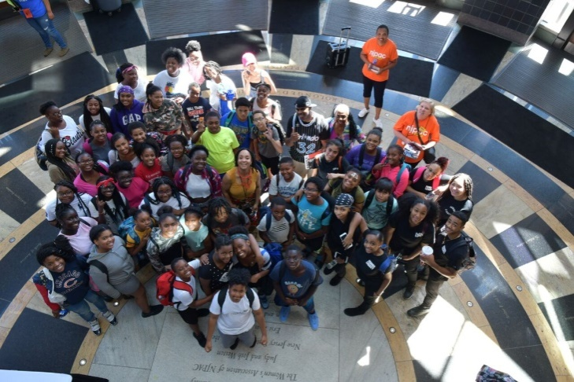
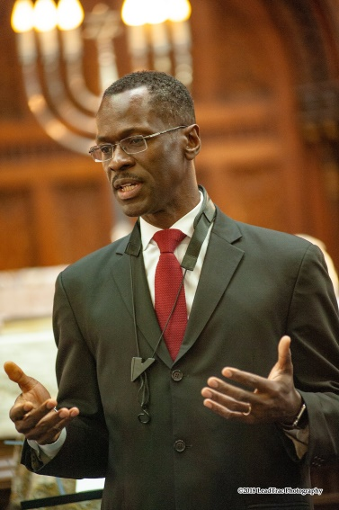
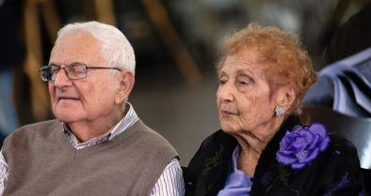
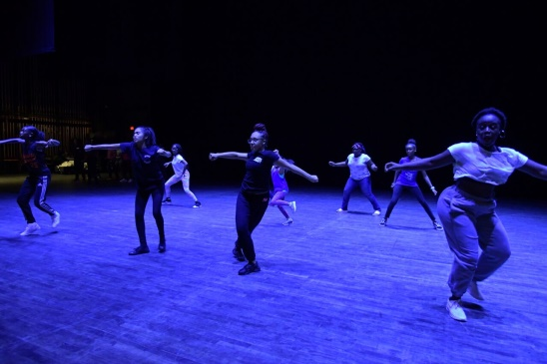
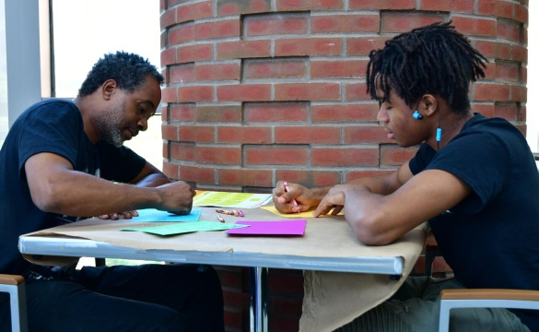
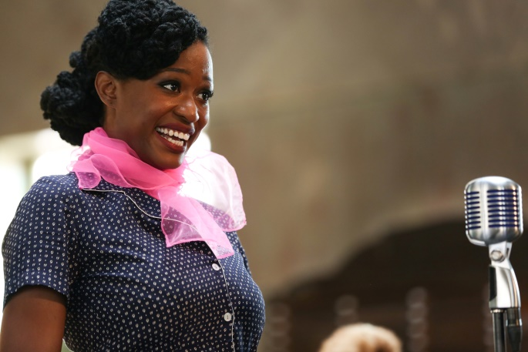
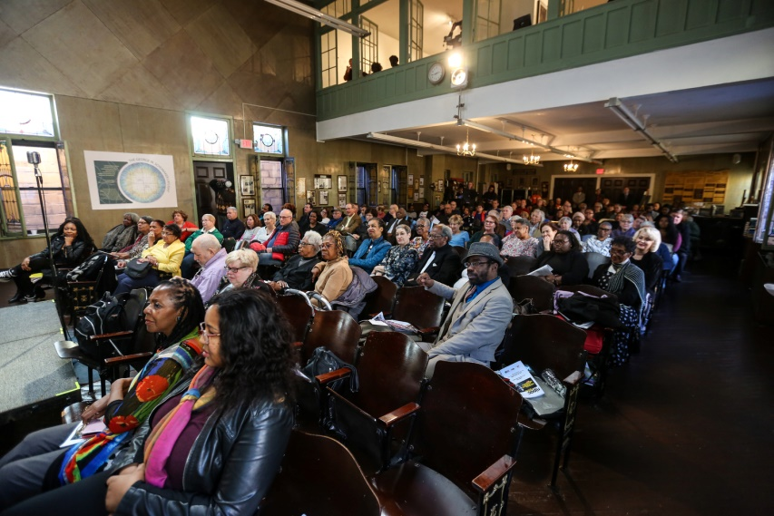
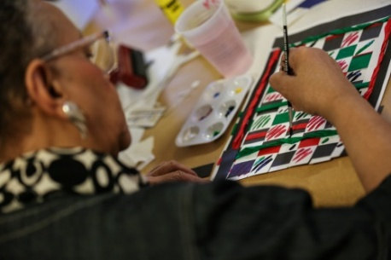
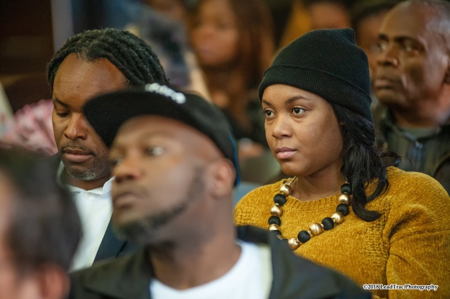
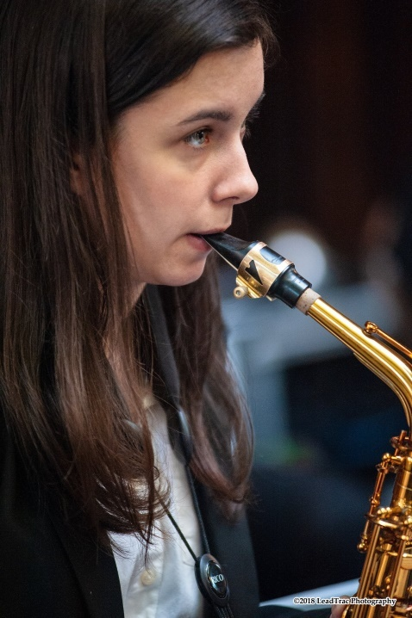
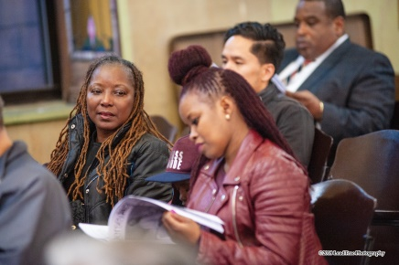
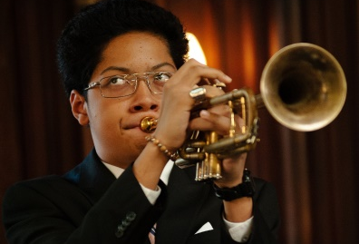
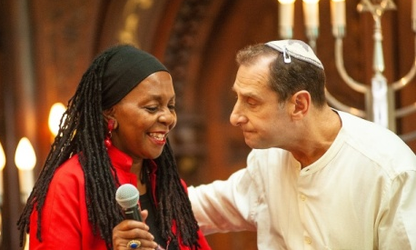
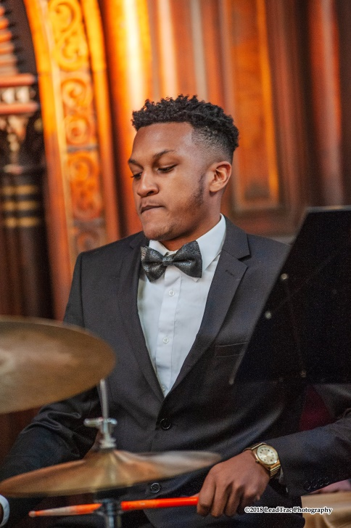
Jazz at Ahavas Sholom, March 25th

Slide 15
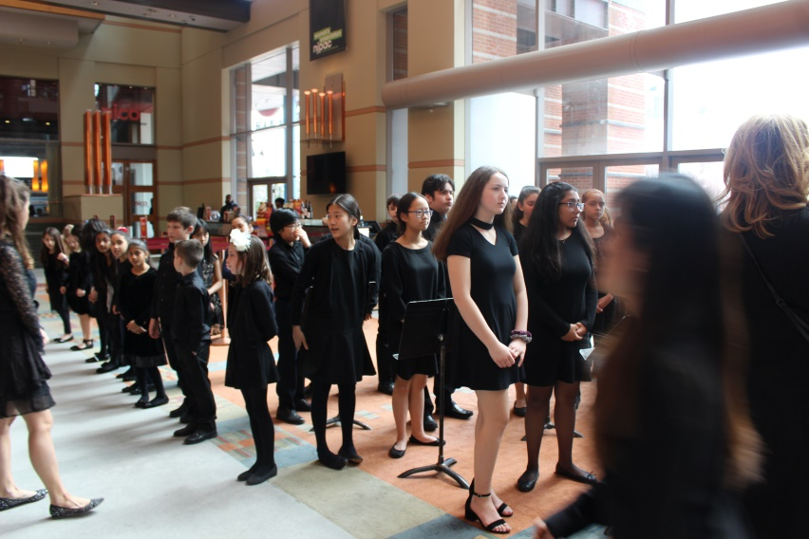
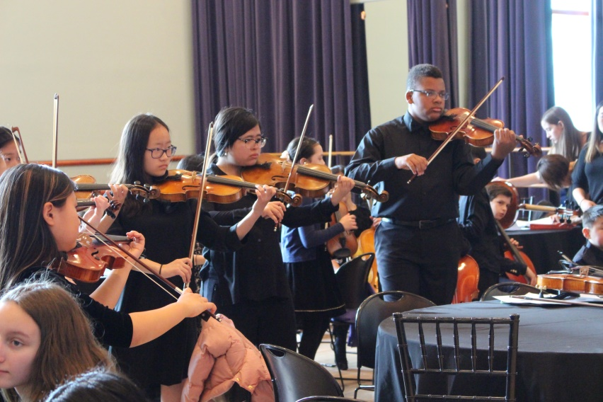
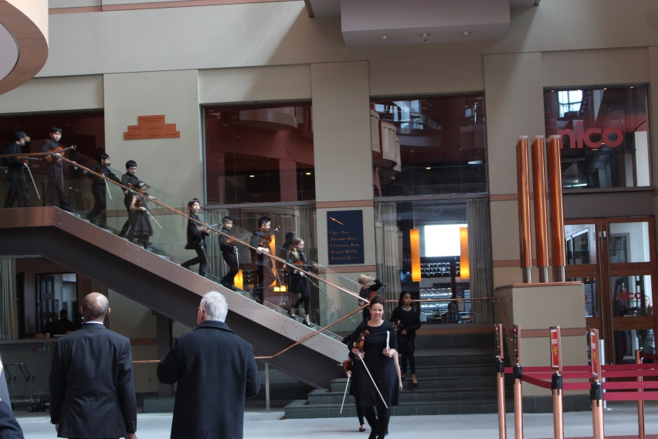
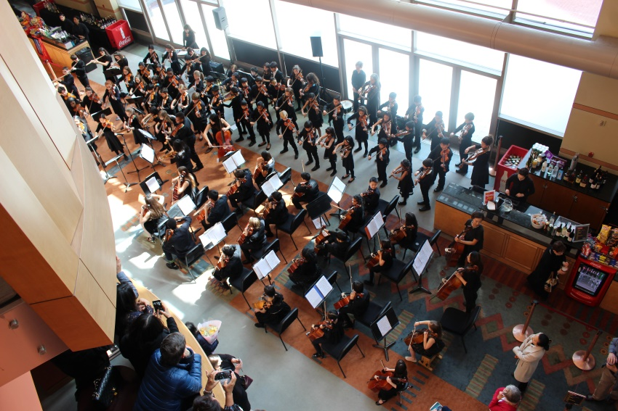
Preludes 2022 – ELISABETH MORROW SCHOOL

Slide 16
TEN TOOLS TO BUILD DIVERSE AUDIENCES
Investment
Audience development is a long-term labor-intensive process that also requires a sense of vision and purpose. The focus is to target a diverse group to become ticket buyers for an event.

Slide 17
Commitment
Expanding your life to support your goals. Placing yourself in the very environment that you want to cultivate.

Slide 18
Research
Ask questions that will inform your efforts. We cannot assume or carry presupposed ideas on cultural behavior.

Slide 19
Review and analysis
Take stock of what you have learned and understanding of your internal capacity, what you can honestly accomplish with your current resources.

Slide 20
Follow-up
Deliver whatever you promise,
keep your word.

Slide 21
Partnership
Everyone is equal.
Collaborate with cultural and commercial enterprises that will enhance both of you.

Slide 22
Educating your artists and audiences
Take the time to demystify
the art product

Slide 23
Building the bridge
What are the breadcrumbs along the way that signal you are safe and that you will be welcome.

Slide 24
Creating value
Distributing complimentary tickets does not assist in one's efforts to cultivate a new audience. Build a relationship and create cultural events to serve as a point of entry for long lasting experiences.

Slide 25
Appreciation
Always remember to say
thank you.

Slide 26
Break Out – Dreaming Out Loud
Discuss and prepare a synopsis of a program at a select arts organization that incorporates community engagement and or audience development in a significant way. Discuss the impact on the community and internally at the arts organization.

Slide 27
Rules of Engagement
Leave titles outside the zoom space
Listen to the other person speaking
One person be prepared to share
Assume you have the budget you need
Dream out loud
You have 15 minutes
5 groups will report

Slide 28
Long term perspective
We must focus on the fact the EDIA work never stops. It is important that our colleagues and partners that have close relationships with us feel that the EDIA initiative is positively reshaping our internal work culture.

Slide 29
There are no shortcuts
“There are no shortcuts nor silver bullets for enabling inclusive workplaces. You can senda powerful message as an ally in a position of power and influence when you’re the one who takes up the work.”
- Daisy Auger-Dominguez

Slide 30
The Hill We Climb
“…the New Dawn blooms as we free it, for there is always light if only we’re brave enough to see it, if only we’re brave enough to be it.”
- Amanda Gorman

